Slide 1
ICS2O0 (Grade 10 Computer Science)
Mr. Nestor
(gregory.nestor@peelsb.com)
(p0079141@pdsb.net)

Slide 2
Module A1.2 – Sep 06
Agenda
Attendance / Introductions
Module A1.2 - Simon Game – Level 2
Debrief Questions
Upcoming
Tomorrow: Simon Level 3

Slide 3
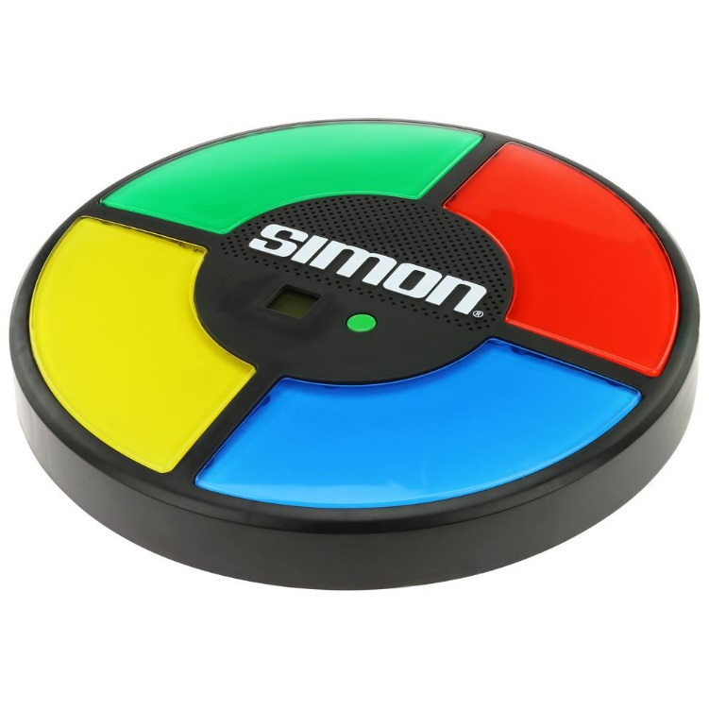
Debrief-1
What is the oldest game system you have played on? (either console or hand held)
What features of Simon are similar to modern game systems?

Slide 4
Debrief-2
Who Created Simon?
How is Simon related to the creation of the first game systems?

